Slide 1
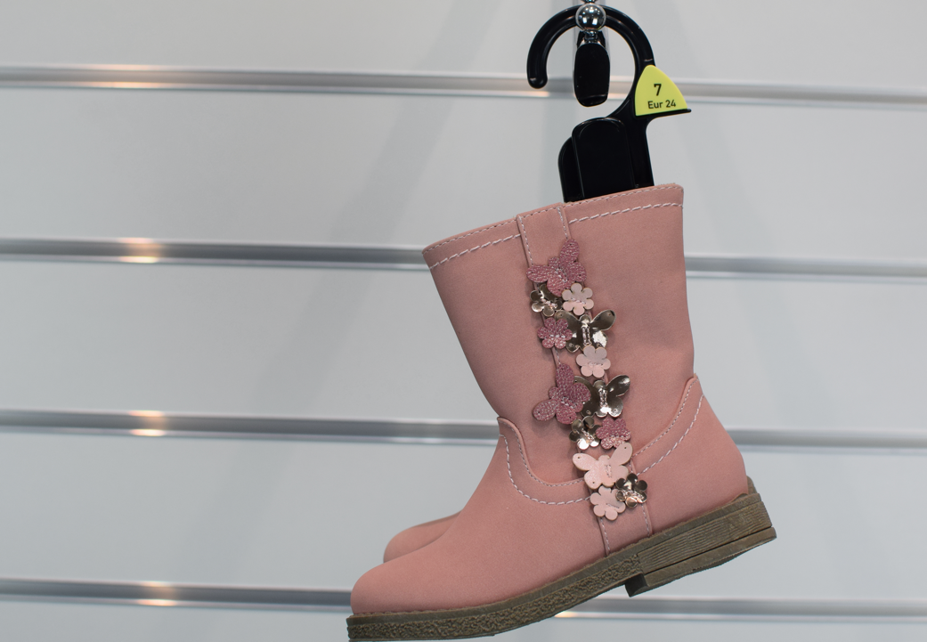


F&F Hanger
Manual
Supply Regions – China, Bangladesh,
Sri Lanka & Vietnam
AUGUST 2021

Slide 2
Introduction
There is a wide variety of hangers available and it is the buyer’s responsibility to choose the correct hanger for their product and ensure it is fit for purpose in the fit session.
If a buyer wishes to apply for a new hanger shape they need to complete a hanger application form (held in design.com) for the relevant hanger supplier for the region concerned
Hanger codes follow the below rules:
The first letter is the type of hanger
The second letter is the hanger section
The numbers after the letters indicate the width of the hanger
The last letter represents the colour of the hanger
For example. The TU41B
T = Tops hanger
U = U section hanger
41 = 41cm wide
B = Black
Please note there are a few select hangers that do not follow this rule

Slide 3
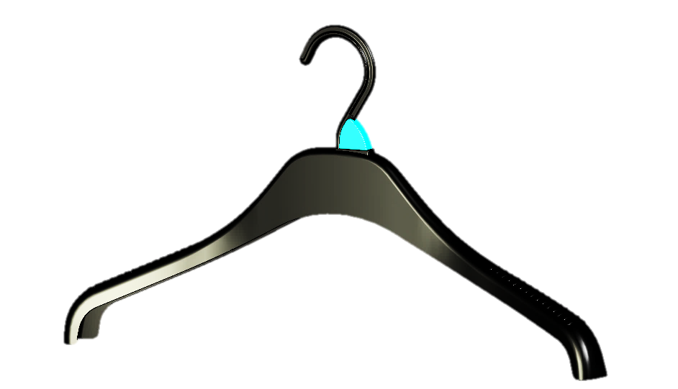
What hanger to choose?
What types of hangers are there?
If you were to cut a hanger across the cross-section what shape would that cut look like? We tend to look at hanger types by letters. Predominantly used are U section C section, & T section. We also use flat hangers but these are normally used for accessories.
The type of section determines how strong the hanger is. Some heavier garments will require a stronger hanger than others.
U Section Hangers
Strongest of all section hangers
PROS | Great for heavier garments, come with polycarbonate hook for hanging in transport
CONS | Contains a greater amount of material so are more expensive
GARMENTS | Heavy tops, jackets, knitwear, adult trousers such as jeans
HANGERS | JU38/42/46 JUM38/42/46 KU41/45, KNU41/46 TU41/47 BU33

Slide 4
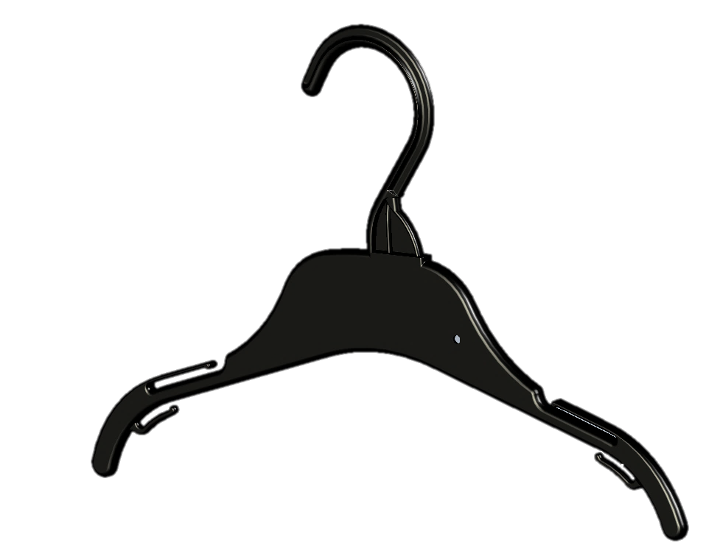
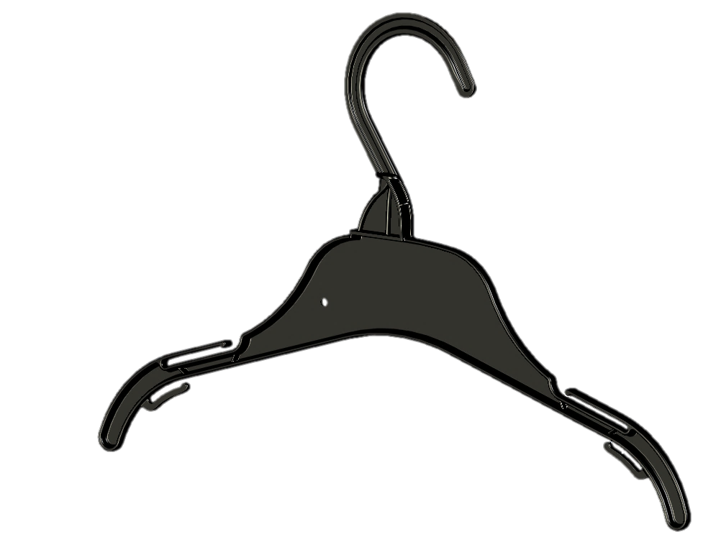
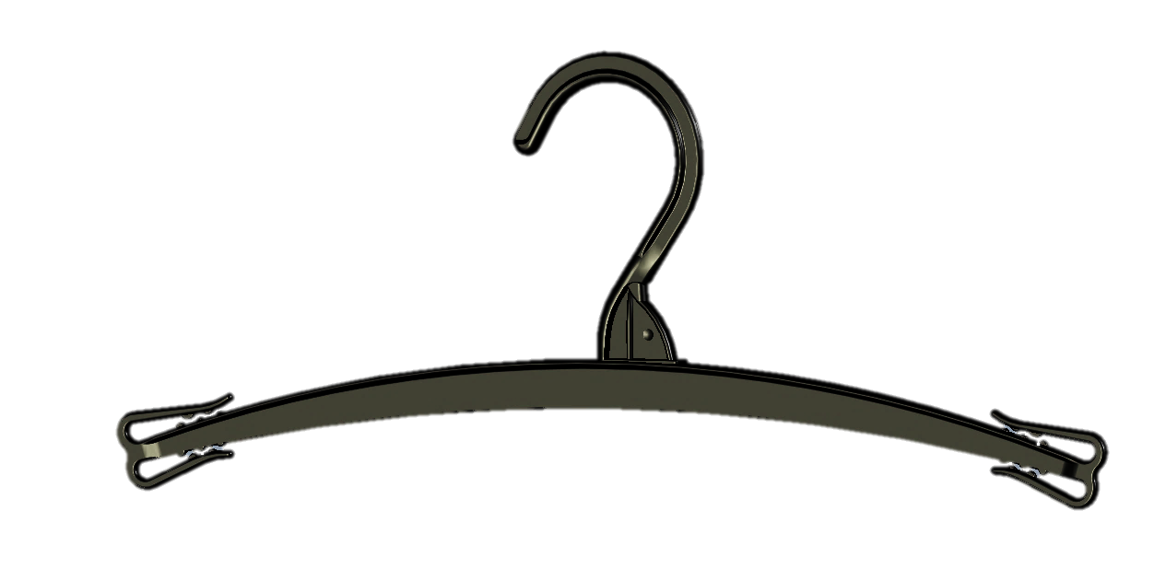
What hanger to choose?
C Section Hangers
Lighter hanger that is great for lighter garments and children’s clothing.
PROS | Cost effective hanger that can accommodate majority of lighter garments
CONS | Unsuitable for heavy jacket and knitwear. Polystyrene hook so unsuitable for hanging transport
GARMENTS | Childrenswear, adult t-shirts and lightweight tops, leggings, lightweight trousers, lingerie, swimwear
HANGERS | TC222/26/30/36/41/47 TC22/26/30/36/41 DTC22/26/30/36/41 FC22/26/30/36/41 SWC26/30/36 BC22/28 PC19/26/33 BRF125 – Lingerie NC30 – Lingerie SW121/24/27/32 - Swimwear
T Section Hangers
Very light hanger used for lingerie. BRA130 - Bras

Slide 5
Hanger Colours by Dept
Each department has an assigned hanger colour:
All hangers must be the correct colour for the product department.
Ladies | Black
Men’s | Black
Ladies essentials | Cream
Mens’ essentials | Black
Kids essential | Pearl
Ladies Nightwear | Cream
Men’s Nightwear | Black
Kids Nightwear | Black
School | Black
Babywear | Pearl
Kidswear | Black
Footwear & Accessories | Black
Kids Footwear & Accessories | Black

Slide 6
Glossary
BRA | Bra Hanger
BRF | Brief Hanger
BC | Bottoms C Section
BU | Bottoms U Section
DTC | Double Tops C Section
FC | Frame C Section
FFF | Flip Flop Footwear
FW | Footwear
FWBC | Boot Clip
FWHT | Footwear Heel Tab
JU | Jacket U Section
JUM | Jacket U Section with Metal Hook
KU | Knitwear U Section
KNU | Knitwear U Section – wide version
NC | Nightwear C Section
PC | Prong Clip
SC | Scarf Hanger
SC | Size Clip
SW | Swimwear hanger
SWC | Sleepwear C Section
SWR | Sleepwear Rail Lock Hanger
TB | Trouser Bar
TC | Top C Section
TDL | Top Drop Loop
TU | Top U Section

Slide 7
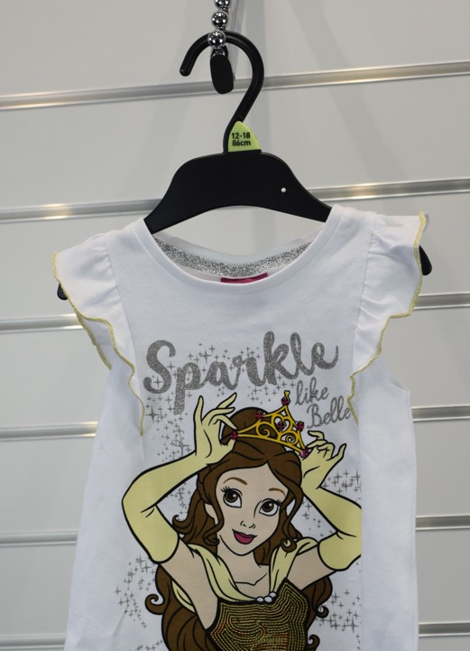
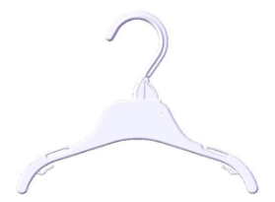
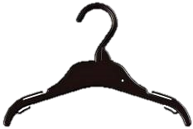
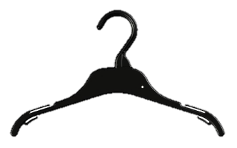
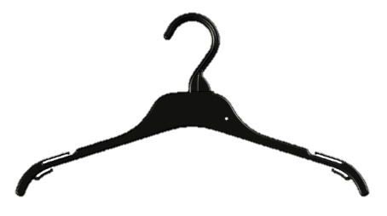
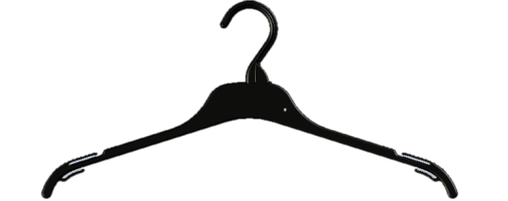
Childrenswear
Hanger in photo – TC226B
Lighter Tops Hangers
Suitable for T-shirts, Vests
and Light Garments
TC222P
SIZES | 22cm – ages 0-3Mths 26cm – ages 3-12Mths 30cm – ages 1/12-4yrs 36cm – ages 5-10yrs 41cm – ages 11+yrs
COLOUR | Pearl (22cm) Pearl & Black (26 & 30cm) Black (36 & 41cm)
AVAILABLE | China Sri Lanka Bangladesh
TC226B/P
TC230B/P
TC236B
TC241B
This is a guide only. Hanger size will vary dependant on style of garment. Please check before ordering.

Slide 8
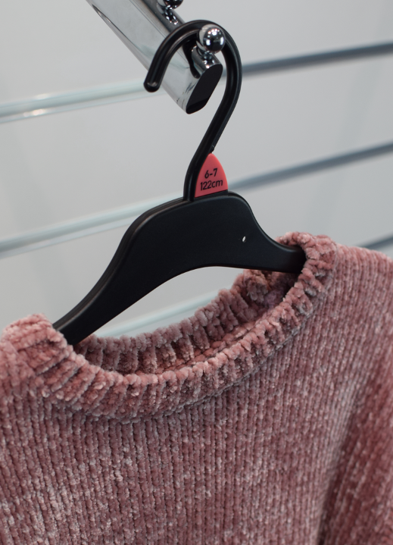
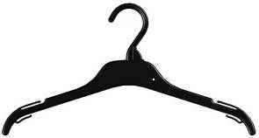
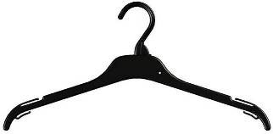
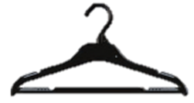

Childrenswear
Hanger in photo – SWC36B
Tops Hangers
Suitable for Tops, Vests and Shirts
TC36B
SIZES | 36cm – ages 5-10yrs 41cm – ages 11+yrs
COLOUR | Black
AVAILABLE | China Bangladesh
TC41B
Tops Hangers with bar
Suitable for Children’s Knitwear & Jackets
SWC36B
SIZES | 36cm – ages 5-10yrs (only China) 41cm – ages 11+yrs (only BD)
COLOUR | Black
AVAILABLE | China (only 36cm) Bangladesh (only 41cm)
SWC41B
This is a guide only. Hanger size will vary dependant on style of garment. Please check before ordering.

Slide 9
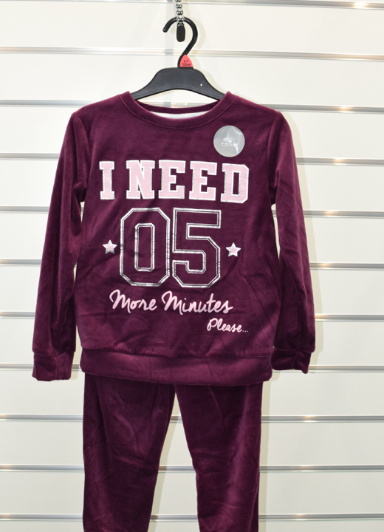
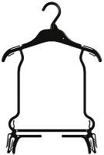
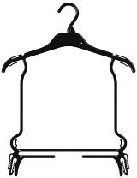
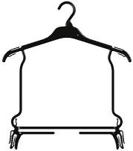
Childrenswear
Hanger in photo – FC41B
Frame Hangers
Suitable for Tops and Bottoms Sets
SIZES | 30cm – ages 1/12-4yrs 36cm – ages 5-10yrs 41cm – ages 11+yrs
COLOUR | Pearl & Black (30cm) Black (36 & 41cm)
AVAILABLE | China Sri Lanka Bangladesh
FC30B/P
FC36B
FC41B
This is a guide only. Hanger size will vary dependant on style of garment. Please check before ordering.

Slide 10
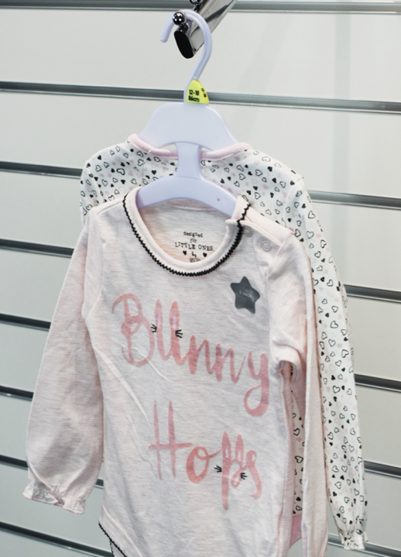
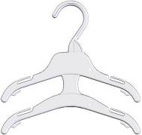
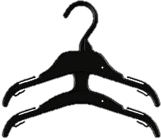
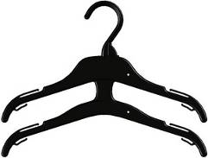
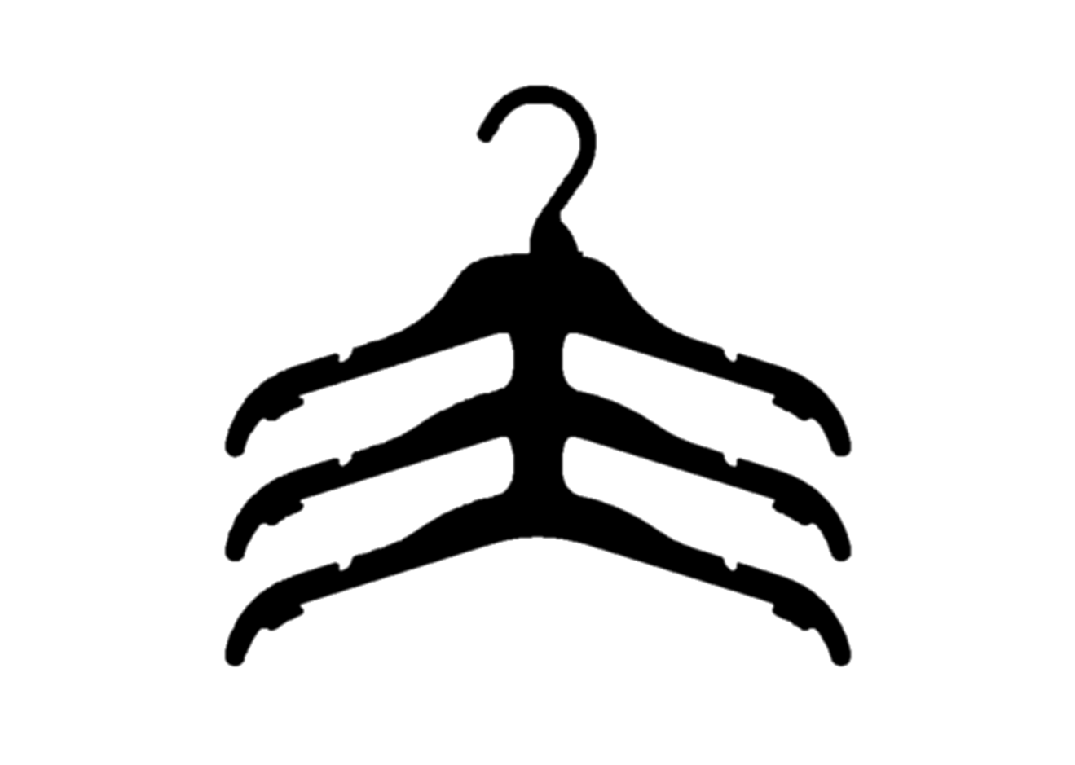
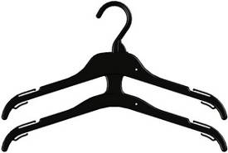
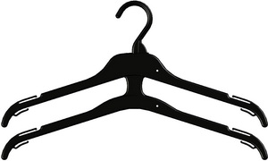
Childrenswear
Hanger in photo – DTC26P
Double/Triple Tops Hangers
Suitable for Tops ,Vests and Shirts
DTC22P
SIZES | 22cm – ages 0-3Mths 26cm - ages 3-12Mths 30cm – ages 1/12-4yrs 36cm – ages 5-10yrs 41cm – ages 11+yrs
COLOUR | Pearl (22cm) Pearl & Black (26 & 30cm) Black (36 & 41cm)
AVAILABLE | China (22cm, 26cm & 30cm) Sri Lanka Bangladesh (TTC30B only available Ex BD)
DTC26B
DTC30B
TTC30B
DTC36B
DTC41B
This is a guide only. Hanger size will vary dependant on style of garment. Please check before ordering.

Slide 11
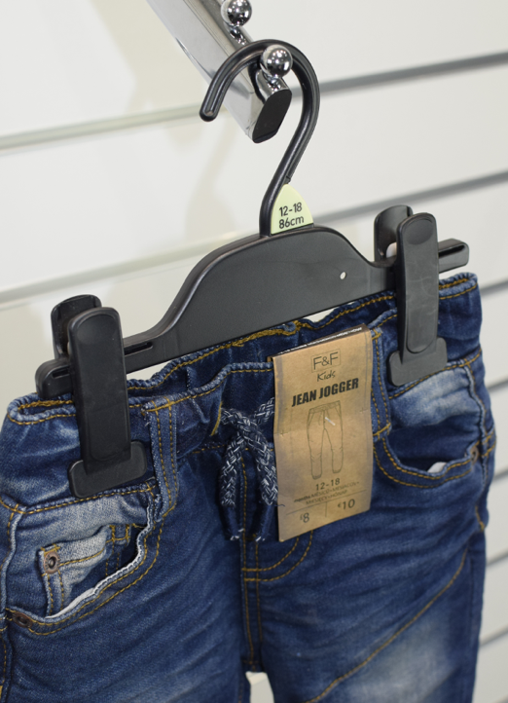
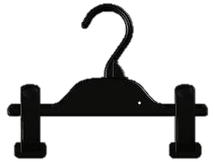
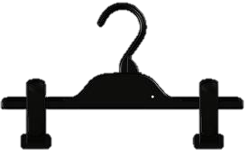
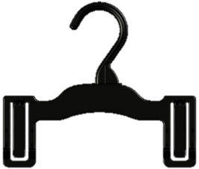
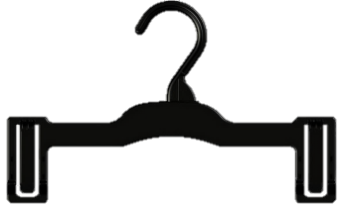
Childrenswear
Hanger in photo – BC22B
Clip Hangers
Suitable for Trousers, Jeans,
Shorts & Leggings
BC22B/P
SIZES | 22cm – ages 1/12-4yrs 28cm – ages 5+yrs
COLOUR | Pearl & Black (22cm) Black (28cm)
AVAILABLE | China Sri Lanka Bangladesh
BC28B
Croc Clip Hangers
Suitable Casual Shorts & Swim Shorts
PC19B/P
SIZES | 19cm – ages 1/12-4yrs 26cm – ages 4+yrs
COLOUR | Pearl & Black (19cm) Black (26cm)
AVAILABLE | China Sri Lanka Bangladesh
PC26B
This is a guide only. Hanger size will vary dependant on style of garment. Please check before ordering.

Slide 12
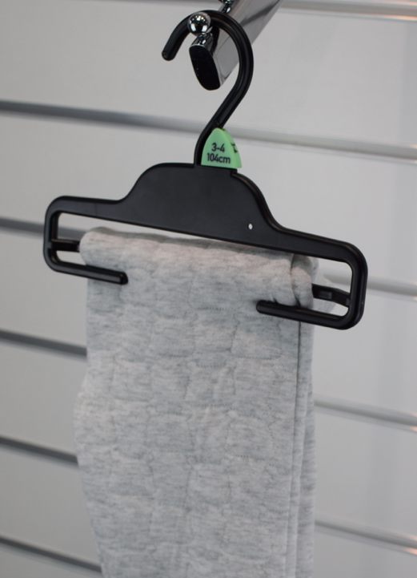
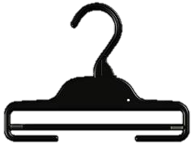


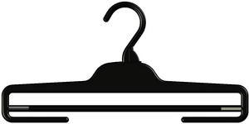
Childrenswear
Hanger in photo – TB23B
Trouser Bar Hangers
Suitable Trousers & Jeans
TB19B/P
SIZES | 19cm – ages 0-6Mths 23cm – ages 11/2-4yrs 26cm – ages 4-6yrs 31cm – ages older kids
COLOUR | Pearl & Black (19cm) Black (23,26 & 31cm)
AVAILABLE | China Sri Lanka Bangladesh
TB23B
TB26B
TB31B
This is a guide only. Hanger size will vary dependant on style of garment. Please check before ordering.

Slide 13
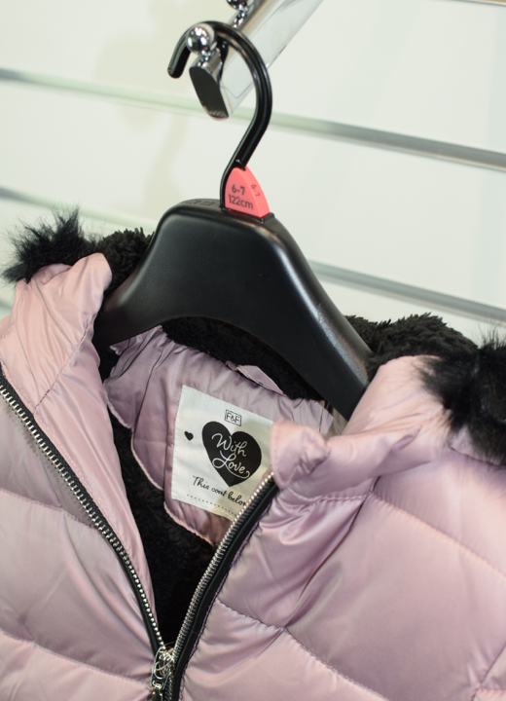
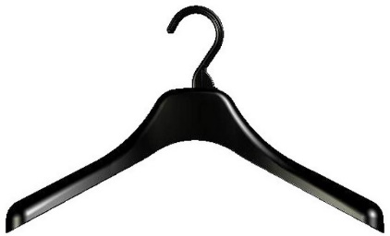
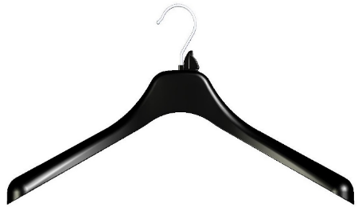
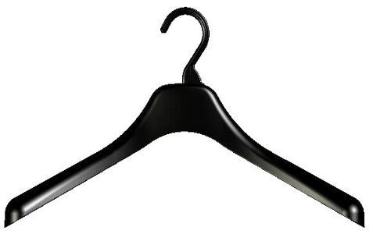

Childrenswear
Hanger in photo – JU38B
Jacket Hangers
Suitable Jackets & Coats, available in Metal and PC hook both suitable for hanging transport
JU38B
SIZES | 38cm – ages 6-14yrs 42cm – ages 16+
COLOUR | Black
AVAILABLE | China Sri Lanka Vietnam
JUM38B
JU42B
JUM42B
This is a guide only. Hanger size will vary dependant on style of garment. Please check before ordering.

Slide 14
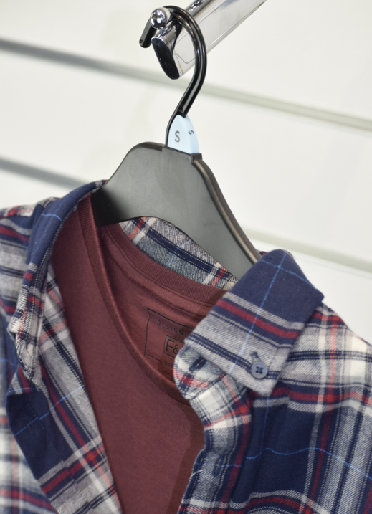
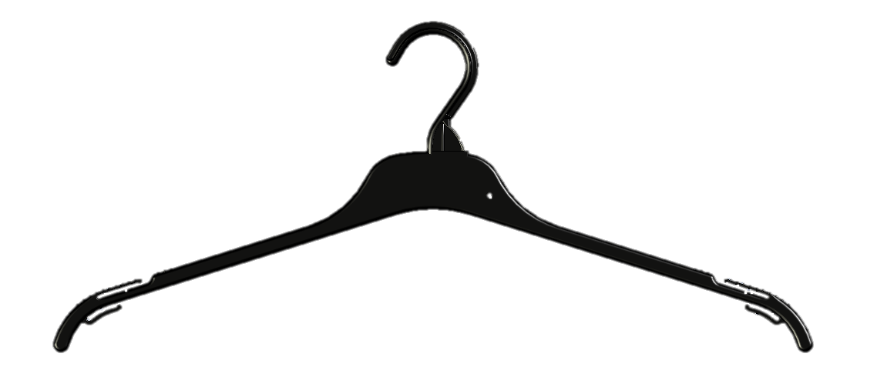
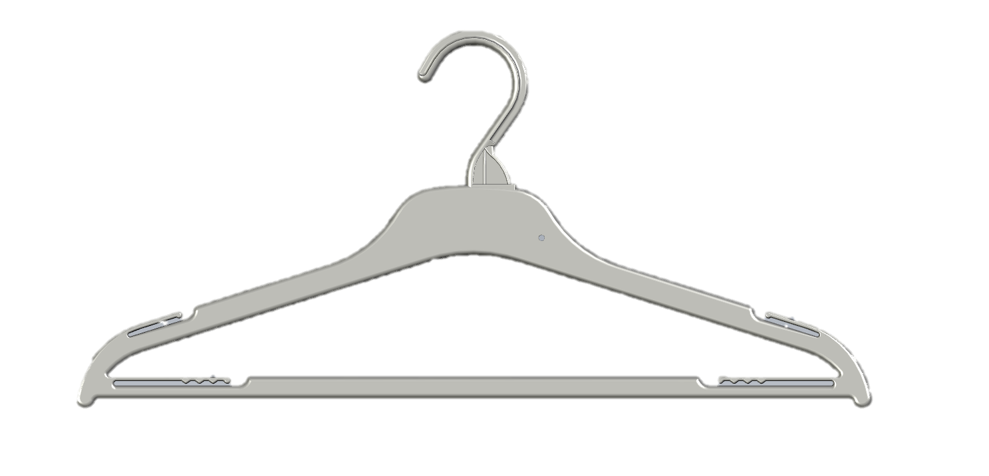
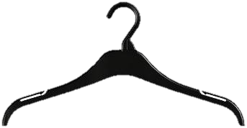
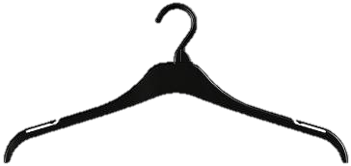
Adultwear
Hanger in photo – TU47B
Lighter Tops Hangers
Suitable for T-shirts, Vests and
Light Garments
TC241B
SIZES | 41cm – Size 6-14, XS-M 47cm – Size 16+,L+
COLOUR | Black Cream (Cream for nightwear only)
AVAILABLE | China Sri Lanka Bangladesh (SWC41B/CM only available Bangladesh)
TC247B
SWC41B/CM
U Section Tops Hangers
Suitable for T-shirts, Vests and Shirts.
PC hook Suitable for hanging transport
SIZES | 41cm – Size 6-14, XS-M 47cm – Size 16+,L+
COLOUR | Black Cream (Cream for nightwear only)
AVAILABLE | China Sri Lanka Bangladesh
TU41B/CM
TU47B/CM
This is a guide only. Hanger size will vary dependant on style of garment. Please check before ordering.

Slide 15
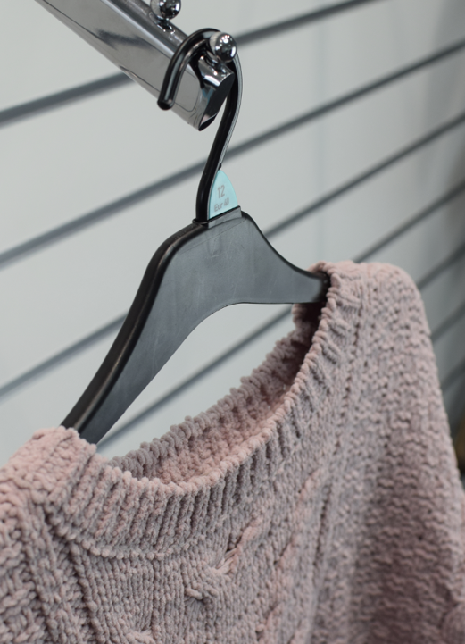
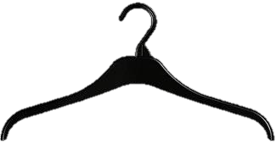
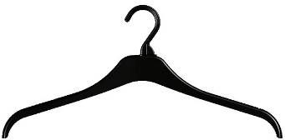
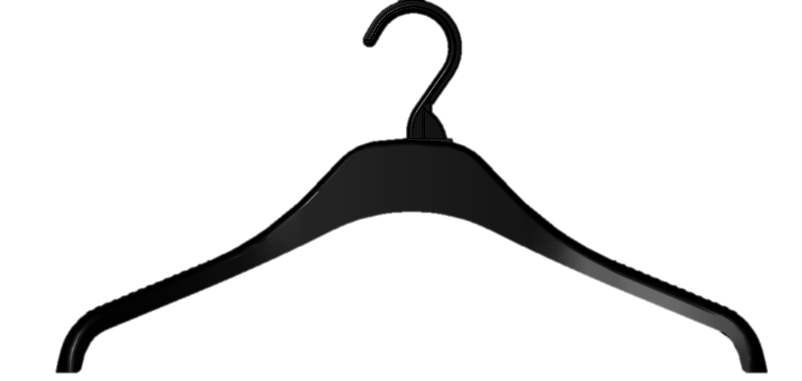
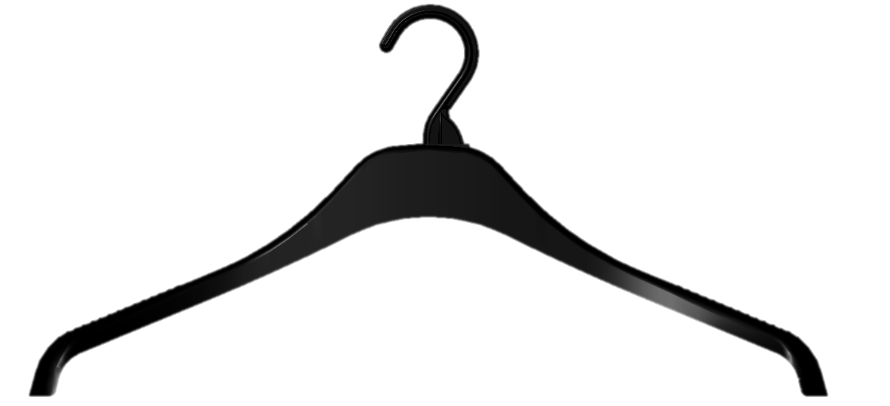
Adultwear
Hanger in photo – KU41B
Knitwear Hangers
Suitable for knitted jumpers and cardigans.
PC hook suitable for hanging transport
KU41B
SIZES | 41cm – Size 6-14, XS-M 45cm – Size 16+,L+
COLOUR | Black
AVAILABLE | China Bangladesh
KU45B
Wide End Knitwear Hangers
Suitable for cable knitted jumpers
and cardigans. PC hook Suitable
for hanging transport
KNU41B
SIZES | 41cm – Size 6-14, XS-M 46cm – Size 16+,L+
COLOUR | Black
AVAILABLE | China Bangladesh
KNU46B
This is a guide only. Hanger size will vary dependant on style of garment. Please check before ordering.

Slide 16
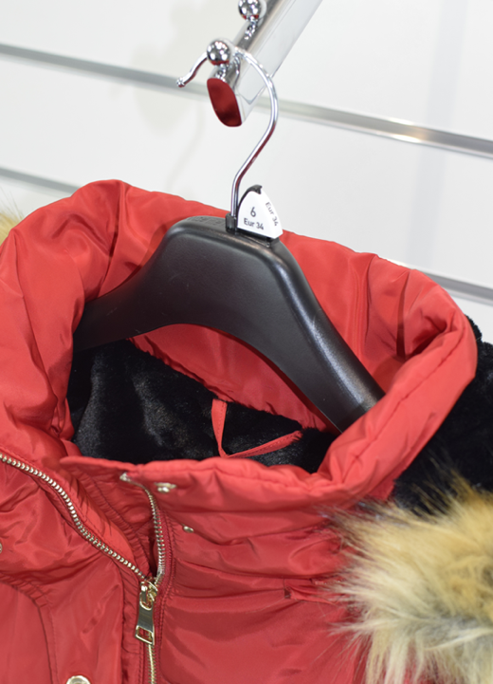
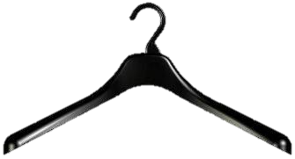

Adultwear
Hanger in photo – JUM42B
Jacket Hangers
Suitable Jackets & Coats, available in Metal and PC hook both suitable for shipping hanging
JU42B
SIZES | 42cm – 6-14, XS – M 46cm – 16+, L+
COLOUR | Black
AVAILABLE | China Sri Lanka Vietnam
JUM42B
JU46B
JUM46B
This is a guide only. Hanger size will vary dependant on style of garment. Please check before ordering.

Slide 17



Adultwear
Hanger in photo – TB34B-F
Clip Hangers
Suitable Trousers, Jeans,
Shorts & Leggings
BC22A-SPB
SIZES | 22cm – all sizes 33cm – all sizes (BU33 only has PC hook suitable for shipping hanging)
COLOUR | Black
AVAILABLE | China, Sri Lanka (BC22A- SPB/BU33B) Bangladesh (BC22A-SPB, BU33B/BC33B) Vietnam (BU33B only)
BU33B/BC33B
TB34B
Trouser Bar Hangers
Suitable Formal Trousers, Casual Trousers,
& Jeans
SIZES | 34cm – All Sizes 34cm with Foam – All Sizes
COLOUR | Black
AVAILABLE | China Bangladesh
TB34B-F
This is a guide only. Hanger size will vary dependant on style of garment. Please check before ordering.

Slide 18




Lingerie
Hanger in photo – BRF125B
BRA130CM
Suitable for Bras
SIZES | 30cm – All Sizes
COLOUR | Cream
AVAILABLE | China Sri Lanka Bangladesh
BRA130CM
NC30B
Suitable Bras, Nightwear
SIZES | 30cm – All Sizes
COLOUR | Black
AVAILABLE | China
NC30B
BRF125CM
Suitable ladies underwear
SIZES | 25cm – All Sizes
COLOUR | Cream
AVAILABLE | China Sri Lanka Bangladesh
BRF125CM
This is a guide only. Hanger size will vary dependant on style of garment. Please check before ordering.

Slide 19





Swimwear
Hanger in photo – SW124B
Swimwear Hangers
Suitable for all swimwear
SW121B
SIZES | 21cm – Children 24cm – Children 27cm – Older Children/ Adults 32cm - Adults
COLOUR | Black
AVAILABLE | China
SW124B
SW127B
SW132B
This is a guide only. Hanger size will vary dependant on style of garment. Please check before ordering.

Slide 20





Footwear
Hanger in photo – FW216B
10.5cm
Toes Up
Suitable for Formal Shoes, Court Shoes,
Slippers and Trainers
FW2162 – 16cm
15.5cm
SIZES | 16cm – Ladies & Children’s formal shoes 21cm – Ladies & Children’s shoe 26cm – Larger Ladies Casual Shoes/Slippers 30cm – Men’s Casual Shoes/ Slippers/Trainers
COLOUR | Black
AVAILABLE | China
FW2210 – 21cm
15.0cm
FW2260– 26cm
24.5cm
FW2300 – 30cm
This is a guide only. Hanger size will vary dependant on style of garment. Please check before ordering.

Slide 21




Footwear
Hanger in photo – FW2320B
15.0cm
Winged Toes Up
Suitable for Formal Shoes, Court Shoes,
Slippers and Trainers
FW2000 – 20cm
SIZES | 20cm – Ladies Formal/ Court Shoes 28cm – Larger Ladies Formal Shoes 32cm – Men’s Formal Shoes
COLOUR | Black
AVAILABLE | China
24.0cm
FW2280 – 28cm
28.0cm
FW2320 – 32cm
This is a guide only. Hanger size will vary dependant on style of garment. Please check before ordering.

Slide 22







Footwear
Hanger in photo – FWBC2B
Boot Clip
Suitable for all Boots & Wellingtons
SIZES | Straight – Standard boots Winter – Cuffed/ Padded Boots
COLOUR | Black
AVAILABLE | China
FWBC1B
Flip Flop
Suitable sizes of flip flops
FWBC2B
SIZES | One Size
COLOUR | Black
AVAILABLE | China
FFF101B
Baby Bootie
Suitable baby shoes and booties
SIZES | One Size
COLOUR | Pearl
AVAILABLE | China
FWHT2P
This is a guide only. Hanger size will vary dependant on style of garment. Please check before ordering.

Slide 23



Accessories
Hanger in photo – SC225B
SC225B
Suitable for scarves
SIZES | One Size
COLOUR | Black
AVAILABLE | China
SC225B
TSHS1B
Suitable for packaged shirts
SIZES | One Size
COLOUR | Black
AVAILABLE | Bangladesh
TSHS1B
This is a guide only. Hanger size will vary dependant on style of garment. Please check before ordering.

Slide 24







Accessories
Hanger in photo – SWR23B
Pyjama Hanger
Suitable for Pyjamas
SWR23B
SIZES | SWR23 – 23cm hanger SWR27 – 27cm hanger
COLOUR | Black
AVAILABLE | Bangladesh – (SWR23 only) China – (SWR27 only)
SWR27B
Drop Loop
Suitable baby shoes and booties
SIZES | 2cm – short drop loop 8cm – long drop loop
COLOUR | Black, Pearl & Cream (TDL2/8 only) Black (ACK244)
AVAILABLE | China, Sri Lanka & Bangladesh (ACK244 available in China & Bangladesh only)
TDL2/8B/P/CM
ACK244B
Size Clip
SIZER
Various colours with detailed size information
This is a guide only. Hanger size will vary dependant on style of garment. Please check before ordering.

Slide 25
Packing Method
You will need to consider whether or not the garment should be sent hanging in transit or flat packed. For example kids, BTS shirts would be ideal for blue trays and would generally not be considered for hanging in transit.
Length 60 cm
Height 24cm
Garments that are too large for our blue boxes (see measurements) should be considered for hanging in transit and not boxed as this causes increased workload for depot and added complexity to load.
Anything that goes in a blue box must go to depot number 460. If it does not fit in a blue box it must go to depot number 461.
Width across the top of the tray is 40cm

Slide 26


Slide 27

Thank You
Pact Reuse Retail Accessories

